Slide 1
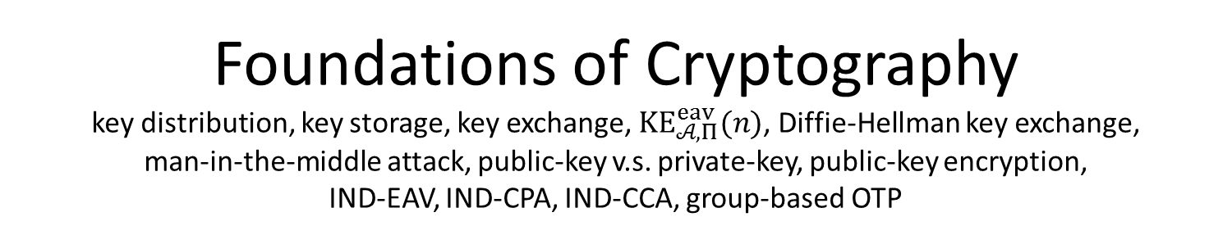
Foundations of Cryptography key distribution, key storage, key exchange, $KE_{𝒜,Π}^{eav}(n)$, Diffie-Hellman key exchange, man-in-the-middle attack, public-key v.s. private-key, public-key encryption, IND-EAV, IND-CPA, IND-CCA, group-based OTP
LiangFeng Zhang
zhanglf@shanghaitech.edu.cn

Slide 2
Private-Key Cryptography
Confidentiality: Prevent Unauthorized Access
Private Key Encryption
Historical Ciphers, One Time Pad
Computational Security; IND-EAV; PRG; Stream Cipher
IND-CPA; PRF; PRP; Block Cipher; Modes of Operation
LFSR, eStream, RC4, DES, AES
Integrity: Prevent (Detect) Unauthorized Modification
MAC, CBC-MAC; IND-CCA
CRHF, MD Transform, HMAC
MD5, SHA-1,2,3

Slide 3
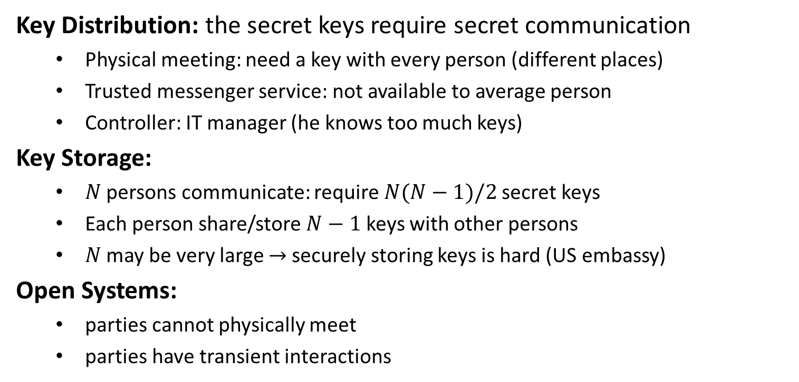
Drawbacks
Key Distribution: the secret keys require secret communication
Physical meeting: need a key with every person (different places)
Trusted messenger service: not available to average person
Controller: IT manager (he knows too much keys)
Key Storage:
$N$ persons communicate: require $N(N−1)/2$secret keys
Each person share/store $N−1$ keys with other persons
$N$ may be very large $→$securely storing keys is hard (US embassy)
Open Systems:
parties cannot physically meet
parties have transient interactions

Slide 5
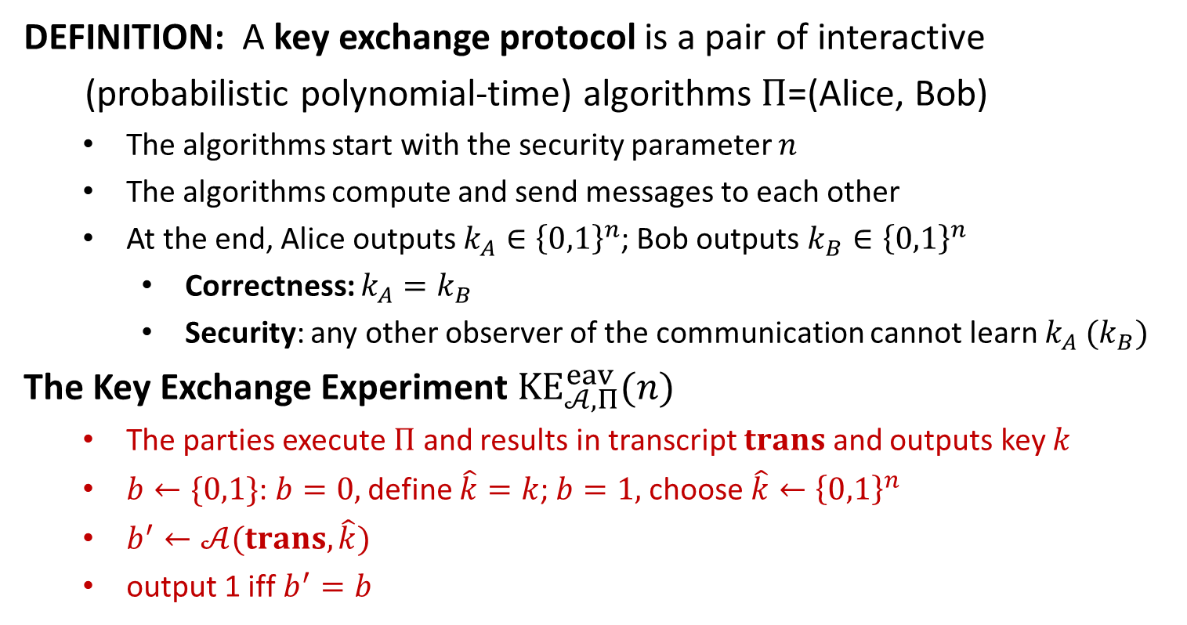
Key Exchange
DEFINITION: A key exchange protocol is a pair of interactive
(probabilistic polynomial-time) algorithms $Π$=(Alice, Bob)
The algorithms start with the security parameter $n$
The algorithms compute and send messages to each other
At the end, Alice outputs $k_{A}∈{\left\{0,1\right\}}^{n}$; Bob outputs $k_{B}∈{\left\{0,1\right\}}^{n}$
Correctness: $k_{A}=k_{B}$
Security: any other observer of the communication cannot learn $k_{A} (k_{B})$
The Key Exchange Experiment $KE_{𝒜,Π}^{eav}(n)$
The parties execute $Π$ and results in transcript $trans$ and outputs key $k$
$b←\{0,1\}$: $b=0,$ define $\hat{k}=k$; $b=1,$ choose $\hat{k}←{\left\{0,1\right\}}^{n}$
$b^{′}←𝒜(trans, \hat{k})$
output 1 iff $b^{′}=b$

Slide 6
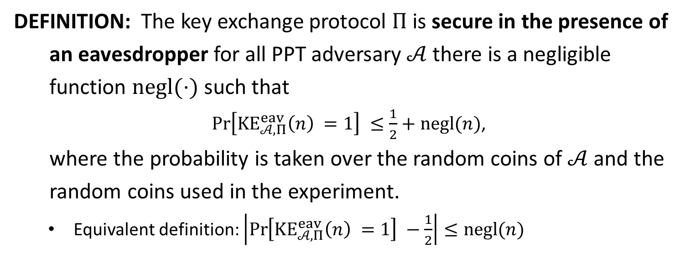
Security
DEFINITION: The key exchange protocol $Π$is secure in the presence of
an eavesdropper for all PPT adversary $𝒜$ there is a negligible
function $negl(⋅)$ such that
$\operatorname{Pr}\left[KE_{𝒜,Π}^{eav}\left(n\right) =1\right] ≤\frac{1}{2}+negl(n)$,
where the probability is taken over the random coins of $𝒜$ and the
random coins used in the experiment.
Equivalent definition: $\left|\operatorname{Pr}\left[KE_{𝒜,Π}^{eav}\left(n\right) =1\right] −\frac{1}{2}\right|≤negl(n)$

Slide 7
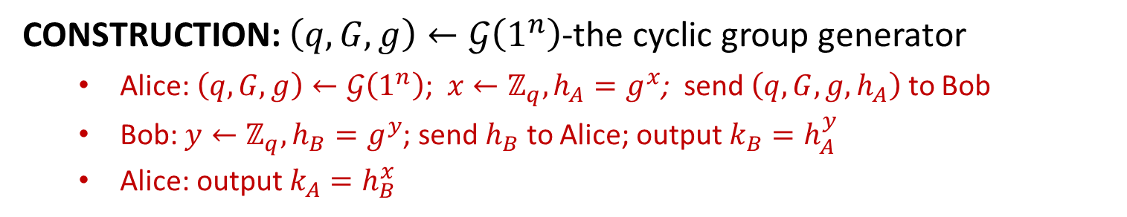
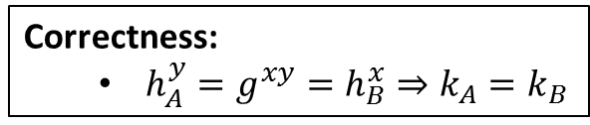
Diffie-Hellman Key Exchange
CONSTRUCTION: $\left(q,G,g\right)←𝒢\left(1^{n}\right)$-the cyclic group generator
Alice: $\left(q,G,g\right)←𝒢\left(1^{n}\right)$; $x←ℤ_{q}, h_{A}=g^{x}$; send $\left(q,G,g,h_{A}\right)$ to Bob
Bob: $y←ℤ_{q}, h_{B}=g^{y}$; send $h_{B}$ to Alice; output $k_{B}=h_{A}^{y}$
Alice: output $k_{A}=h_{B}^{x}$
Correctness:
$h_{A}^{y}=g^{xy}=h_{B}^{x}⇒k_{A}=k_{B}$

Slide 8
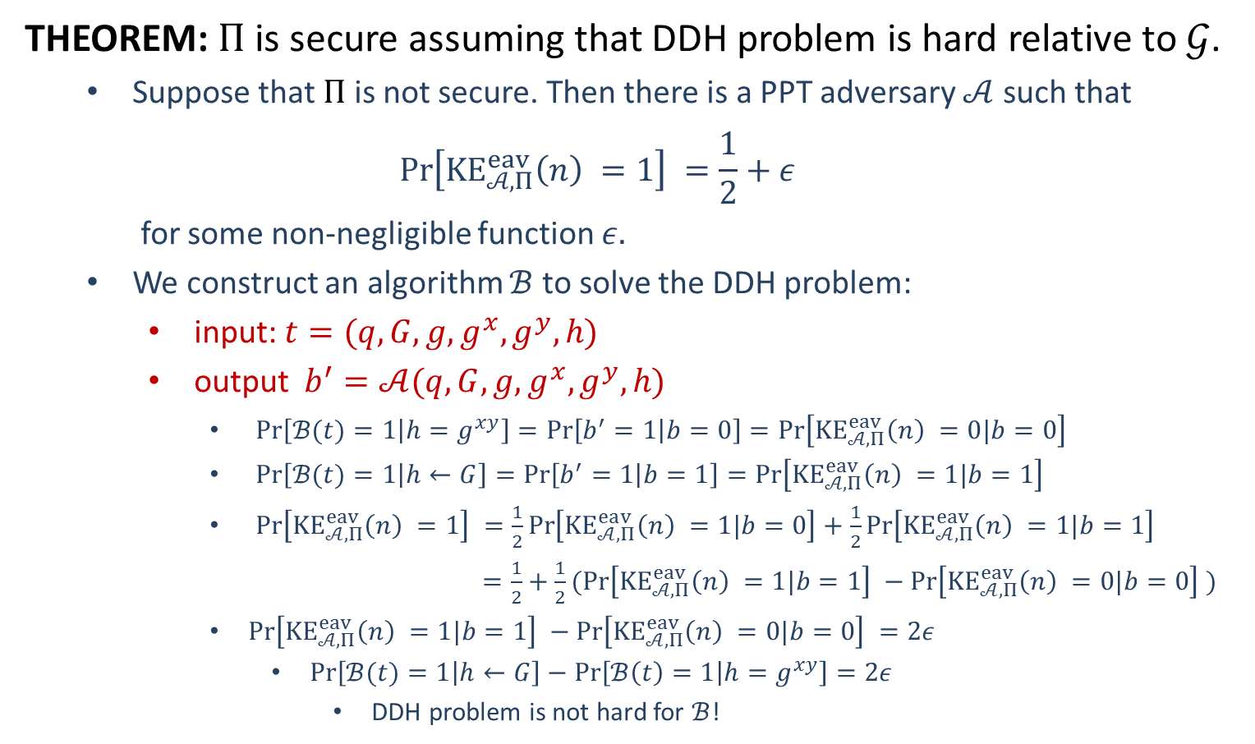
Security
THEOREM: $Π$ is secure assuming that DDH problem is hard relative to $𝒢$.
Suppose that $Π$ is not secure. Then there is a PPT adversary $𝒜$ such that
$$\operatorname{Pr}\left[KE_{𝒜,Π}^{eav}\left(n\right) =1\right] =\frac{1}{2}+ε$$
for some non-negligible function $ε.$
We construct an algorithm $ℬ$ to solve the DDH problem:
input: $t=(q,G,g,g^{x},g^{y},h)$
output $b^{′}=𝒜(q,G,g,g^{x},g^{y},h)$
$\operatorname{Pr}\left[ℬ(t)=1 | h=g^{xy}\right]=\operatorname{Pr}\left[b^{′}=1 | b=0\right]=\operatorname{Pr}\left[KE_{𝒜,Π}^{eav}\left(n\right) =0|b=0\right]$
$\operatorname{Pr}\left[ℬ(t)=1 | h←G\right]=\operatorname{Pr}\left[b^{′}=1 | b=1\right]=\operatorname{Pr}\left[KE_{𝒜,Π}^{eav}\left(n\right) =1|b=1\right]$
$\operatorname{Pr}\left[KE_{𝒜,Π}^{eav}\left(n\right) =1\right] =\frac{1}{2}\operatorname{Pr}\left[KE_{𝒜,Π}^{eav}\left(n\right) =1|b=0\right]+\frac{1}{2}\operatorname{Pr}\left[KE_{𝒜,Π}^{eav}\left(n\right) =1|b=1\right]$
$=\frac{1}{2}+\frac{1}{2}(\operatorname{Pr}\left[KE_{𝒜,Π}^{eav}\left(n\right) =1|b=1\right] −\operatorname{Pr}\left[KE_{𝒜,Π}^{eav}\left(n\right) =0|b=0\right] )$
$\operatorname{Pr}\left[KE_{𝒜,Π}^{eav}\left(n\right) =1|b=1\right] −\operatorname{Pr}\left[KE_{𝒜,Π}^{eav}\left(n\right) =0|b=0\right] =2ε$
$\operatorname{Pr}\left[ℬ(t)=1 | h←G\right]−\operatorname{Pr}\left[ℬ\left(t\right)=1 | h=g^{xy}\right]=2ε$
DDH problem is not hard for $ℬ$!

Slide 10
Public-Key Revolution
“New Directions in Cryptography”
Whitfield Diffie, Martin Hellman (1976) //Turing Award-2015
Scientific Contributions:
Public-Key Encryption: Notion
Digital Signature: Notion
Key Exchange: Notion and the first construction
“Secure Communications over Insecure Channels”
Ralph Merkle (1978)
Scientific Contributions:
Merkle Puzzles: a key exchange protocol

Slide 11
Public-Key Revolution
“A Method for Obtaining Digital Signatures and Public-Key Cryptosystem”
Ron Rivest, Adi Shamir and Leonard Adleman (1977)//Turing Award-2002
Scientific Contributions:
Public-Key Encryption: the first construction
Digital Signature: the first construction
“Digital Signatures and Public-Key Functions as Intractable as Factorization”
Michael O. Rabin (1979) //Turing Award 1976
Scientific Contributions:
Rabin’s Encryption: based on integer factoring

Slide 12
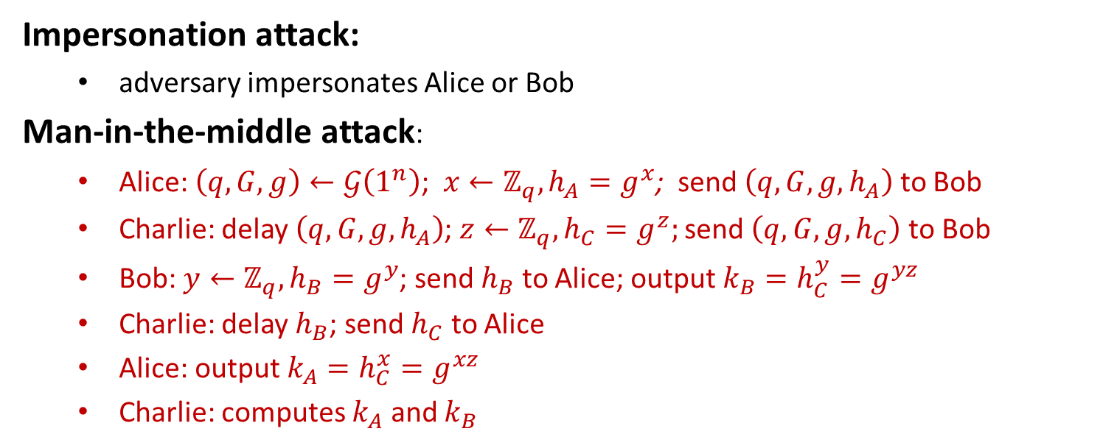
Attacks of Diffie-Hellman KE
Impersonation attack:
adversary impersonates Alice or Bob
Man-in-the-middle attack:
Alice: $\left(q,G,g\right)←𝒢\left(1^{n}\right)$; $x←ℤ_{q}, h_{A}=g^{x}$; send $\left(q,G,g,h_{A}\right)$ to Bob
Charlie: delay $\left(q,G,g,h_{A}\right)$; $z←ℤ_{q}, h_{C}=g^{z};$ send $\left(q,G,g,h_{C}\right)$ to Bob
Bob: $y←ℤ_{q}, h_{B}=g^{y}$; send $h_{B}$ to Alice; output $k_{B}=h_{C}^{y}=g^{yz}$
Charlie: delay $h_{B}$; send $h_{C}$ to Alice
Alice: output $k_{A}=h_{C}^{x}=g^{xz}$
Charlie: computes $k_{A}$ and $k_{B}$

Slide 13
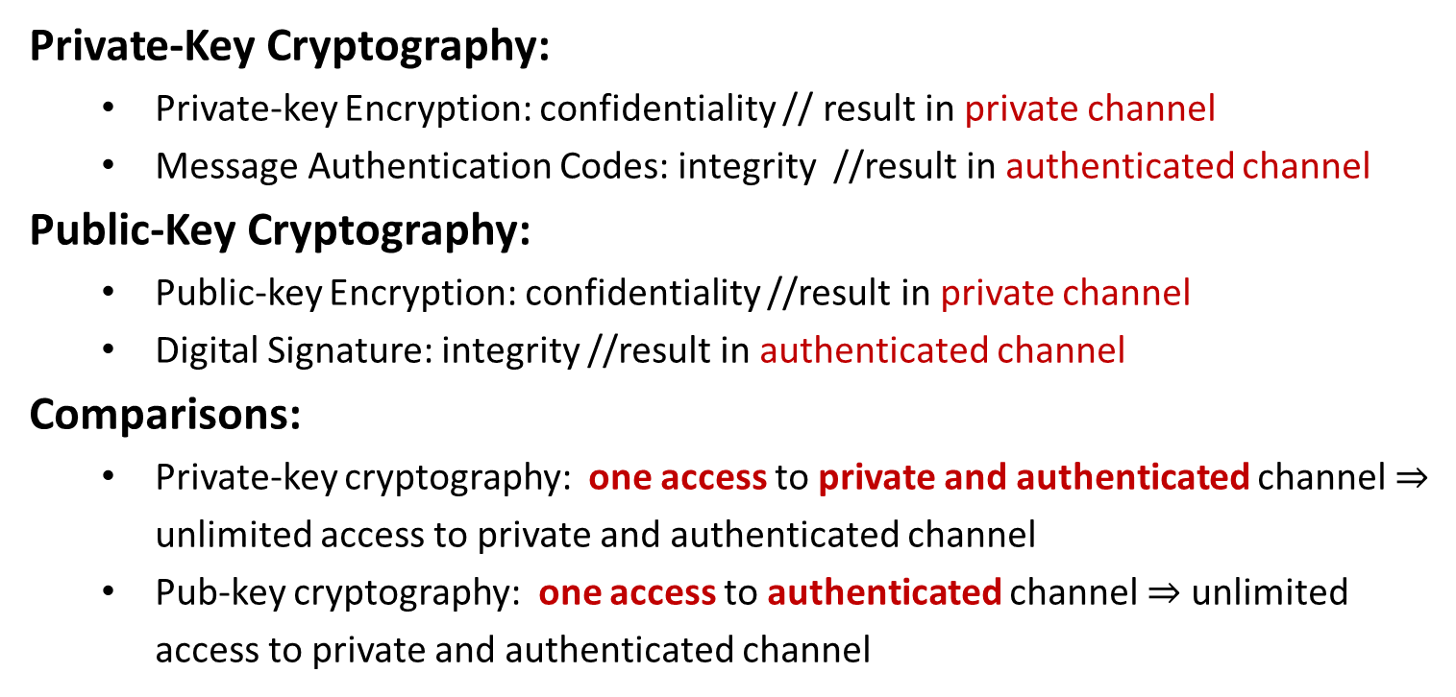
Understanding Public-Key Cryptography
Private-Key Cryptography:
Private-key Encryption: confidentiality // result in private channel
Message Authentication Codes: integrity //result in authenticated channel
Public-Key Cryptography:
Public-key Encryption: confidentiality //result in private channel
Digital Signature: integrity //result in authenticated channel
Comparisons:
Private-key cryptography: one access to private and authenticated channel $⇒$ unlimited access to private and authenticated channel
Pub-key cryptography: one access to authenticated channel $⇒$ unlimited access to private and authenticated channel

Slide 15





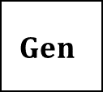

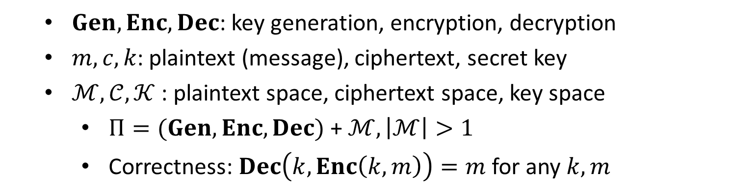
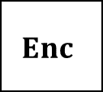


Private-Key Encryption
$$m$$
$$Enc$$
$$c←Enc(k, m)$$
$$Dec$$
Alice
Bob
$$k$$
$$k$$
$$Dec(k, c)=m$$
$$Gen$$
$Gen, Enc, Dec$: key generation, encryption, decryption
$m, c, k$: plaintext (message), ciphertext, secret key
$ℳ,𝒞, 𝒦$ : plaintext space, ciphertext space, key space
$Π=(Gen, Enc, Dec)$ + $ℳ, \left|ℳ\right|>1$
Correctness: $Dec\left(k,Enc\left(k,m\right)\right)=m$ for any $k,m$

Slide 16


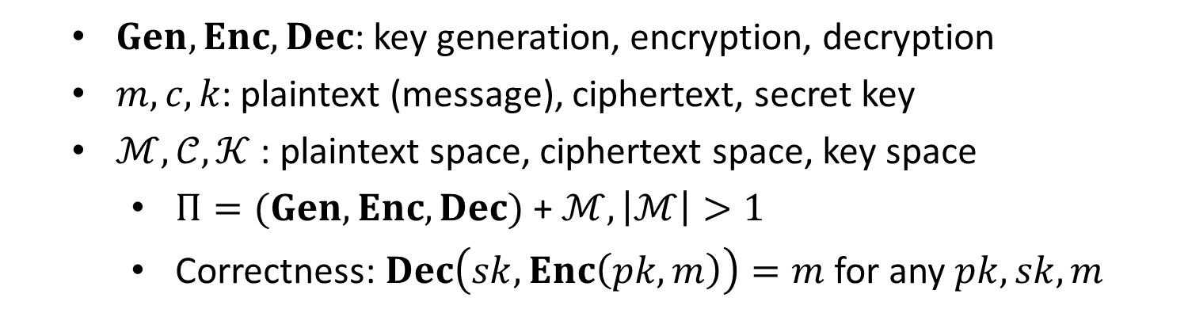


Public-Key Encryption
$$m$$
$$Enc$$
$$c←Enc(pk, m)$$
$$Dec$$
Alice
Bob
$$pk$$
$$sk$$
$$Dec(sk, c)=m$$
$$Gen$$
$Gen, Enc, Dec$: key generation, encryption, decryption
$m, c, k$: plaintext (message), ciphertext, secret key
$ℳ,𝒞, 𝒦$ : plaintext space, ciphertext space, key space
$Π=(Gen, Enc, Dec)$ + $ℳ, \left|ℳ\right|>1$
Correctness: $Dec\left(sk,Enc\left(pk,m\right)\right)=m$ for any $pk,sk,m$

Slide 17
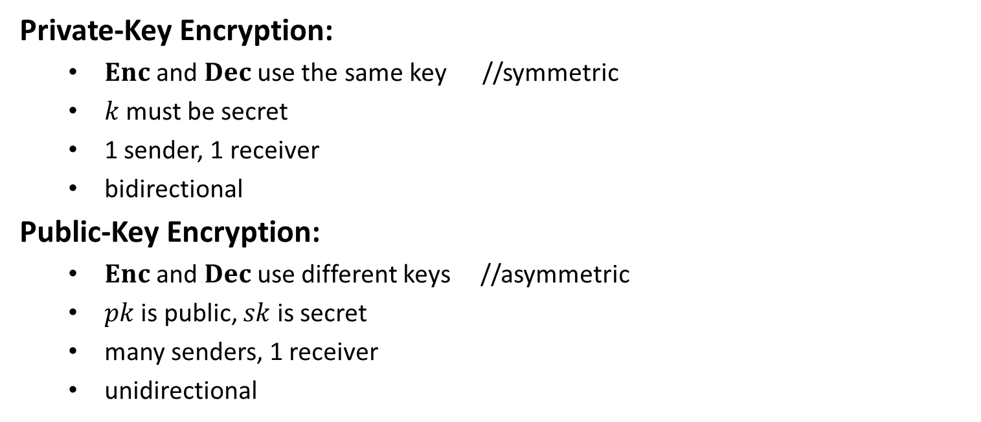
Comparisons
Private-Key Encryption:
$Enc$ and $Dec$ use the same key //symmetric
$k$ must be secret
1 sender, 1 receiver
bidirectional
Public-Key Encryption:
$Enc$ and $Dec$ use different keys //asymmetric
$pk$ is public, $sk$ is secret
many senders, 1 receiver
unidirectional

Slide 18
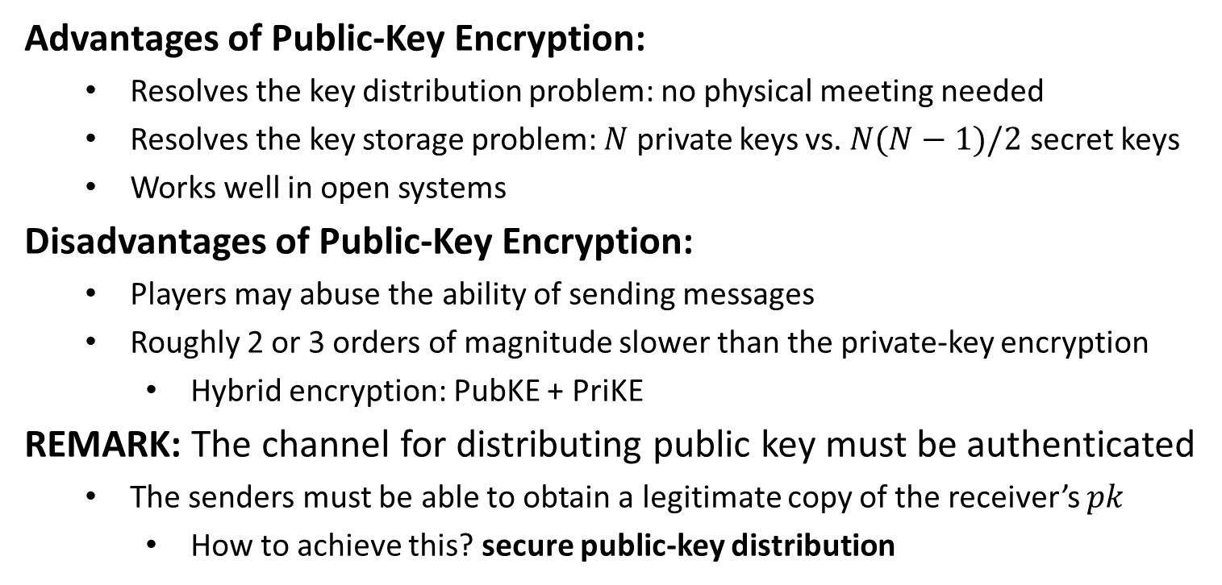
Public-Key Encryption
Advantages of Public-Key Encryption:
Resolves the key distribution problem: no physical meeting needed
Resolves the key storage problem: $N$ private keys vs. $N(N−1)/2$ secret keys
Works well in open systems
Disadvantages of Public-Key Encryption:
Players may abuse the ability of sending messages
Roughly 2 or 3 orders of magnitude slower than the private-key encryption
Hybrid encryption: PubKE + PriKE
REMARK: The channel for distributing public key must be authenticated
The senders must be able to obtain a legitimate copy of the receiver’s $pk$
How to achieve this? secure public-key distribution

Slide 20


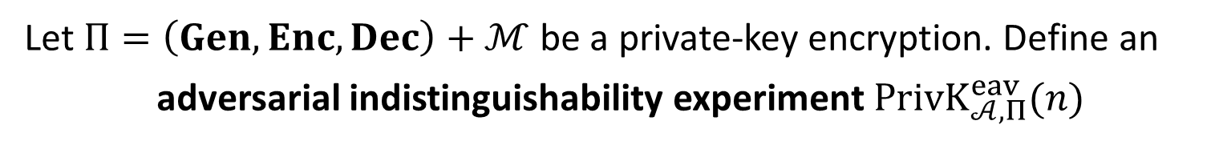



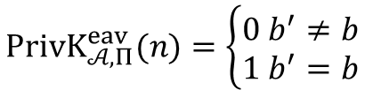


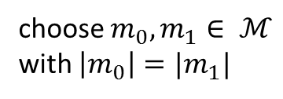

IND-EAV (PriKE)
Let $Π=\left(Gen, Enc, Dec\right)+ℳ$ be a private-key encryption. Define an
adversarial indistinguishability experiment $PrivK_{𝒜, Π}^{eav}(n)$
choose $m_{0}, m_{1}∈ ℳ$
with $\left|m_{0}\right|=|m_{1}|$
$$m_{0},m_{1}$$
$$k←Gen\left(1^{n}\right)$$
$$b←\{0,1\}$$
$$Challenger$$
$$c←Enc(k,m_{b})$$
$$Adversary 𝒜$$
$$c$$
$$b′$$
$$PrivK_{𝒜, Π}^{eav}(n)=\left\{\begin{aligned}0 b^{′}≠b \\ 1 b^{′}=b\end{aligned}\right.$$

Slide 21

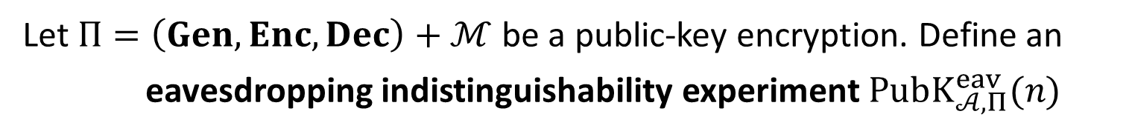


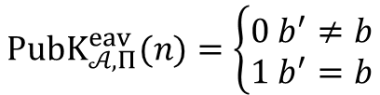

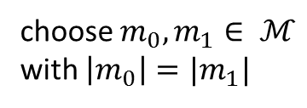

IND-EAV (PubKE)
Let $Π=\left(Gen, Enc, Dec\right)+ℳ$ be a public-key encryption. Define an
eavesdropping indistinguishability experiment $PubK_{𝒜, Π}^{eav}(n)$
$$(pk,sk)←Gen\left(1^{n}\right)$$
$$pk$$
choose $m_{0}, m_{1}∈ ℳ$
with $\left|m_{0}\right|=|m_{1}|$
$$m_{0},m_{1}$$
$$b←\{0,1\}$$
$$Challenger$$
$$c←Enc(pk,m_{b})$$
$$Adversary 𝒜$$
$$c$$
$$b′$$
$$PubK_{𝒜, Π}^{eav}(n)=\left\{\begin{aligned}0 b^{′}≠b \\ 1 b^{′}=b\end{aligned}\right.$$

Slide 22
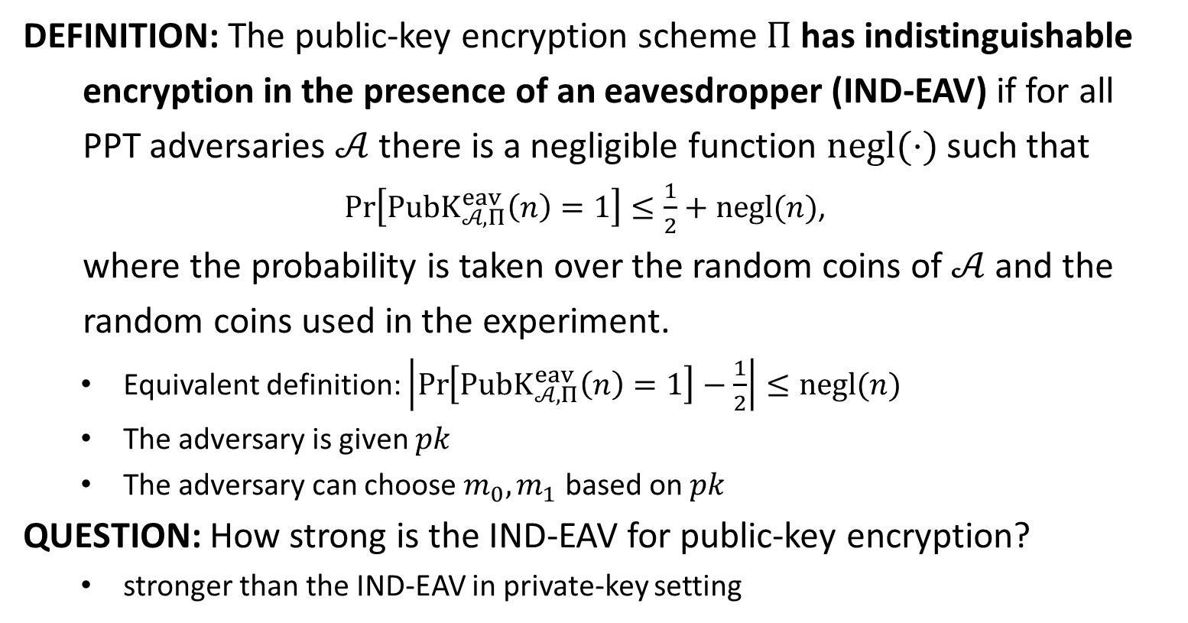
IND-EAV
DEFINITION: The public-key encryption scheme $Π$ has indistinguishable
encryption in the presence of an eavesdropper (IND-EAV) if for all
PPT adversaries $𝒜$ there is a negligible function $negl(⋅)$ such that
$\operatorname{Pr}\left[PubK_{𝒜, Π}^{eav}\left(n\right)=1\right]≤\frac{1}{2}+negl(n)$,
where the probability is taken over the random coins of $𝒜$ and the
random coins used in the experiment.
Equivalent definition: $\left|\operatorname{Pr}\left[PubK_{𝒜, Π}^{eav}\left(n\right)=1\right]−\frac{1}{2}\right|≤negl(n)$
The adversary is given $pk$
The adversary can choose $m_{0},m_{1}$ based on $pk$
QUESTION: How strong is the IND-EAV for public-key encryption?
stronger than the IND-EAV in private-key setting

Slide 23


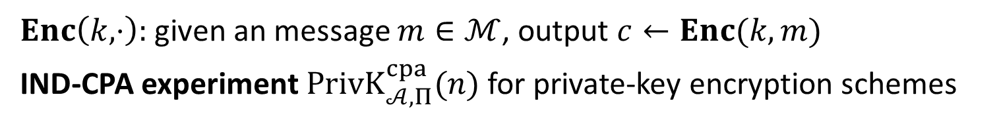










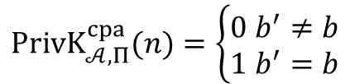

IND-CPA (PrivKE)
$Enc\left(k,⋅\right):$given an message $m∈ℳ$, output $c←Enc(k,m)$
IND-CPA experiment $PrivK_{𝒜, Π}^{cpa}(n)$ for private-key encryption schemes
$$k←Gen\left(1^{n}\right)$$
$$orace access to$$
$$Enc\left(k,⋅\right)$$
$$m_{0},m_{1}$$
$$\left|m_{0}\right|=|m_{1}|$$
$$Challenger$$
$$b←\{0,1\}$$
$$Adversary 𝒜$$
$$c←Enc(k,m_{b})$$
$$c$$
$$orace access to$$
$$Enc\left(k,⋅\right)$$
$$b′$$
$$PrivK_{𝒜, Π}^{cpa}(n)=\left\{\begin{aligned}0 b^{′}≠b \\ 1 b^{′}=b\end{aligned}\right.$$

Slide 24












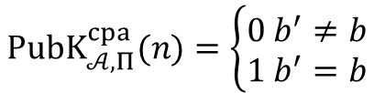

IND-CPA (PubKE)
IND-CPA experiment $PubK_{𝒜, Π}^{cpa}(n)$ for public-key encryption schemes
$$(pk,sk)←Gen\left(1^{n}\right)$$
$$pk$$
$$orace access to$$
$$Enc\left(pk,⋅\right)$$
$$m_{0},m_{1}$$
$$Challenger$$
$$\left|m_{0}\right|=|m_{1}|$$
$$Adversary 𝒜$$
$$b←\{0,1\}$$
$$c←Enc(pk,m_{b})$$
$$c$$
$$orace access to$$
$$Enc\left(pk,⋅\right)$$
$$b′$$
$$PubK_{𝒜, Π}^{cpa}(n)=\left\{\begin{aligned}0 b^{′}≠b \\ 1 b^{′}=b\end{aligned}\right.$$

Slide 25
IND-CPA (PubKE)
IND-CPA experiment $PubK_{𝒜, Π}^{cpa}(n)$ for public-key encryption schemes
$$(pk,sk)←Gen\left(1^{n}\right)$$
$$pk$$
$$m_{0},m_{1}$$
$$Challenger$$
$$\left|m_{0}\right|=|m_{1}|$$
$$Adversary 𝒜$$
$$b←\{0,1\}$$
$$c←Enc(pk,m_{b})$$
$$c$$
$$b′$$
$$PubK_{𝒜, Π}^{cpa}(n)=\left\{\begin{aligned}0 b^{′}≠b \\ 1 b^{′}=b\end{aligned}\right.$$

Slide 26
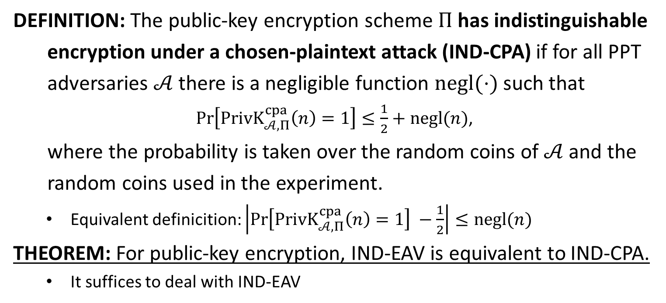
IND-CPA
DEFINITION: The public-key encryption scheme $Π$ has indistinguishable
encryption under a chosen-plaintext attack (IND-CPA) if for all PPT
adversaries $𝒜$ there is a negligible function $negl(⋅)$ such that
$\operatorname{Pr}\left[PrivK_{𝒜, Π}^{cpa}\left(n\right)=1\right]≤\frac{1}{2}+negl(n)$,
where the probability is taken over the random coins of $𝒜$ and the
random coins used in the experiment.
Equivalent definicition: $\left|\operatorname{Pr}\left[PrivK_{𝒜, Π}^{cpa}\left(n\right)=1\right] −\frac{1}{2}\right|≤negl(n)$
THEOREM: For public-key encryption, IND-EAV is equivalent to IND-CPA.
It suffices to deal with IND-EAV

Slide 27

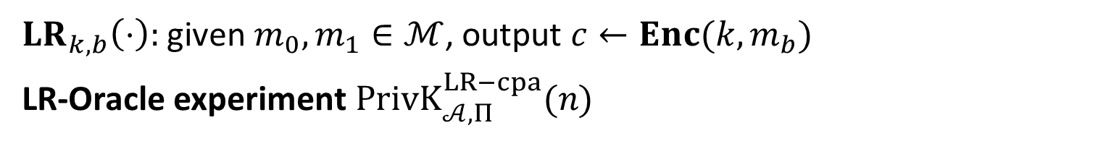






IND-m-CPA (PrivKE)
$LR_{k,b}\left(⋅\right):$given $m_{0},m_{1}∈ℳ$, output $c←Enc(k,m_{b})$
LR-Oracle experiment $PrivK_{𝒜, Π}^{LR−cpa}(n)$
$$k←Gen\left(1^{n}\right)$$
$$b←\{0,1\}$$
$$orace access to$$
$$LR_{k,b}(⋅)$$
$$Challenger$$
$$Adversary 𝒜$$
$$b′$$
$$PrivK_{𝒜, Π}^{LR−cpa}\left(n\right)=1 iff b^{′}=b$$

Slide 28
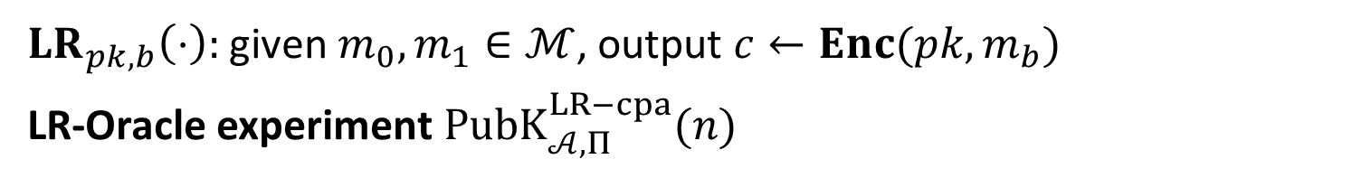



IND-m-CPA (PubKE)
$LR_{pk,b}\left(⋅\right):$given $m_{0},m_{1}∈ℳ$, output $c←Enc(pk,m_{b})$
LR-Oracle experiment $PubK_{𝒜, Π}^{LR−cpa}(n)$
$$(pk,sk)←Gen\left(1^{n}\right)$$
$$b←\{0,1\}$$
$$pk$$
$$orace access to$$
$$Challenger$$
$$LR_{pk,b}(⋅)$$
$$Adversary 𝒜$$
$$b′$$
$$PrivK_{𝒜, Π}^{LR−cpa}\left(n\right)=1 iff b^{′}=b$$

Slide 29
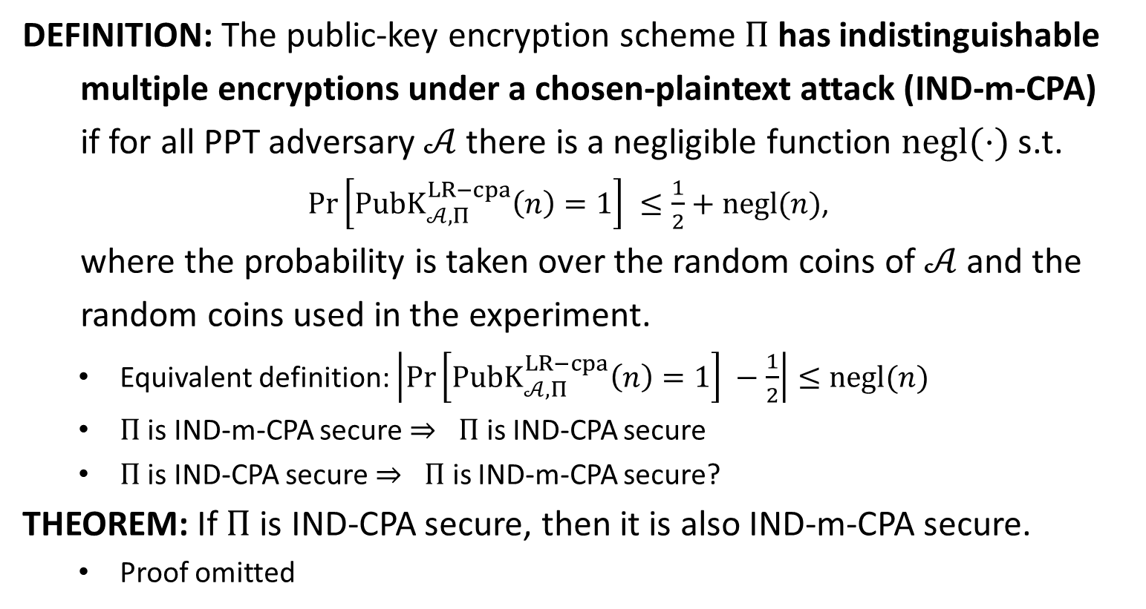
IND-m-CPA (PubKE)
DEFINITION: The public-key encryption scheme $Π$has indistinguishable
multiple encryptions under a chosen-plaintext attack (IND-m-CPA)
if for all PPT adversary $𝒜$ there is a negligible function $negl(⋅)$ s.t.
$\operatorname{Pr}\left[PubK_{𝒜, Π}^{LR−cpa}\left(n\right)=1\right] ≤\frac{1}{2}+negl(n)$,
where the probability is taken over the random coins of $𝒜$ and the
random coins used in the experiment.
Equivalent definition: $\left|\operatorname{Pr}\left[PubK_{𝒜, Π}^{LR−cpa}\left(n\right)=1\right] −\frac{1}{2}\right|≤negl(n)$
$Π$ is IND-m-CPA secure $⇒ Π$ is IND-CPA secure
$Π$ is IND-CPA secure $⇒ Π$ is IND-m-CPA secure?
THEOREM: If $Π$ is IND-CPA secure, then it is also IND-m-CPA secure.
Proof omitted

Slide 30

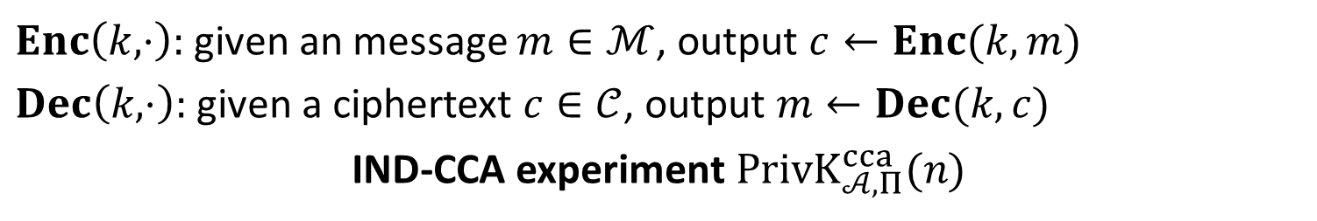









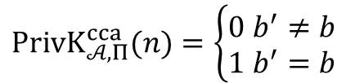

CCA (PrivKE)
$Enc\left(k,⋅\right):$given an message $m∈ℳ$, output $c←Enc(k,m)$
$Dec\left(k,⋅\right):$given a ciphertext $c∈𝒞$, output $m←Dec(k,c)$
IND-CCA experiment $PrivK_{𝒜, Π}^{cca}(n)$
$$k←Gen\left(1^{n}\right)$$
$$oracle access to$$
$$Enc\left(k,⋅\right), Dec(k,⋅)$$
$$m_{0},m_{1}$$
$$\left|m_{0}\right|=|m_{1}|$$
$$Challenger$$
$$b←\{0,1\}$$
$$Adversary 𝒜$$
$$c←Enc(k,m_{b})$$
$$c$$
$$oracle access to$$
$$Enc\left(k,⋅\right), Dec(k,⋅)$$
$$b′$$
$$PrivK_{𝒜, Π}^{cca}(n)=\left\{\begin{aligned}0 b^{′}≠b \\ 1 b^{′}=b\end{aligned}\right.$$

Slide 31



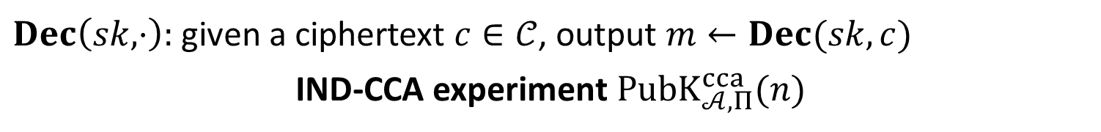











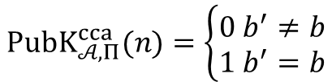

CCA (PubKE)
$Dec\left(sk,⋅\right):$given a ciphertext $c∈𝒞$, output $m←Dec(sk,c)$
IND-CCA experiment $PubK_{𝒜, Π}^{cca}(n)$
$$(pk,sk)←Gen\left(1^{n}\right)$$
$$pk$$
$$oracle access to$$
$$Dec(sk,⋅)$$
$$Challenger$$
$$m_{0},m_{1}$$
$$Adversary 𝒜$$
$$\left|m_{0}\right|=|m_{1}|$$
$$b←\{0,1\}$$
$$c←Enc(k,m_{b})$$
$$c$$
$$oracle access to$$
$$Dec(sk,⋅)$$
$$b′$$
$$PubK_{𝒜, Π}^{cca}(n)=\left\{\begin{aligned}0 b^{′}≠b \\ 1 b^{′}=b\end{aligned}\right.$$
Cannot query with $c$

Slide 32
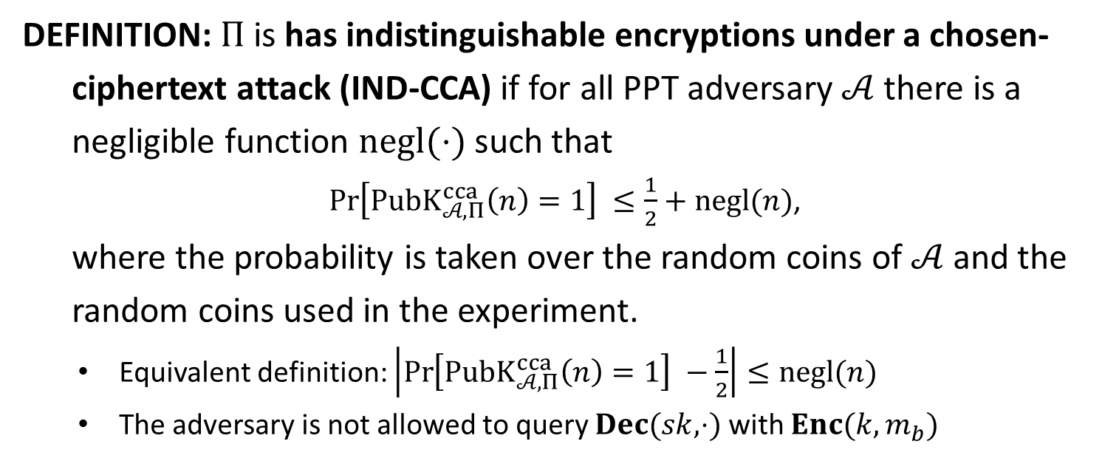
IND-CCA
DEFINITION: $Π$is has indistinguishable encryptions under a chosen-
ciphertext attack (IND-CCA) if for all PPT adversary $𝒜$ there is a
negligible function $negl(⋅)$ such that
$\operatorname{Pr}\left[PubK_{𝒜, Π}^{cca}\left(n\right)=1\right] ≤\frac{1}{2}+negl(n)$,
where the probability is taken over the random coins of $𝒜$ and the
random coins used in the experiment.
Equivalent definition: $\left|\operatorname{Pr}\left[PubK_{𝒜, Π}^{cca}\left(n\right)=1\right] −\frac{1}{2}\right|≤negl(n)$
The adversary is not allowed to query $Dec(sk,⋅)$ with $Enc(k,m_{b})$

Slide 33
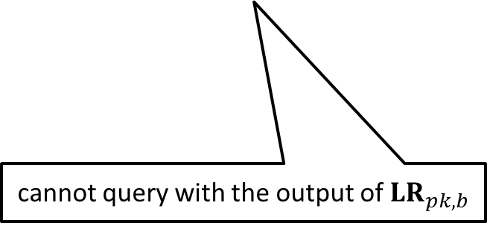
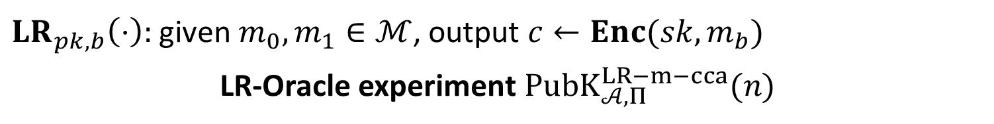
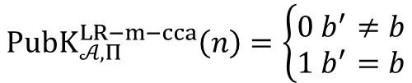






IND-m-CCA
$LR_{pk,b}\left(⋅\right):$given $m_{0},m_{1}∈ℳ$, output $c←Enc(sk,m_{b})$
LR-Oracle experiment $PubK_{𝒜, Π}^{LR−m−cca}(n)$
$$(pk,sk)←Gen\left(1^{n}\right)$$
$$b←\{0,1\}$$
$$pk$$
$$oracle access to$$
$$Challenger$$
$$LR_{pk,b}\left(⋅\right), Dec(sk,⋅)$$
$$Adversary 𝒜$$
$$b′$$
$$PubK_{𝒜, Π}^{LR−m−cca}\left(n\right)=\left\{\begin{aligned}0 b^{′}≠b \\ 1 b^{′}=b\end{aligned}\right.$$
cannot query with the output of $LR_{pk,b}$

Slide 34
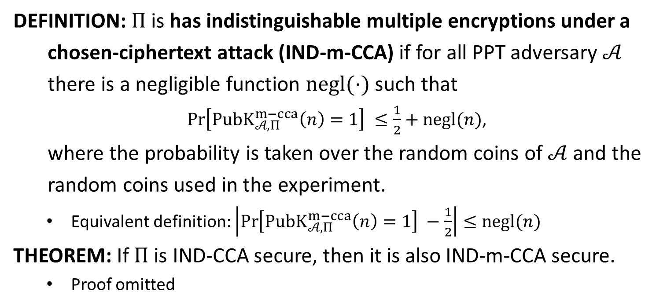
IND-m-CCA
DEFINITION: $Π$is has indistinguishable multiple encryptions under a
chosen-ciphertext attack (IND-m-CCA) if for all PPT adversary $𝒜$
there is a negligible function $negl(⋅)$ such that
$\operatorname{Pr}\left[PubK_{𝒜, Π}^{m−cca}\left(n\right)=1\right] ≤\frac{1}{2}+negl(n)$,
where the probability is taken over the random coins of $𝒜$ and the
random coins used in the experiment.
Equivalent definition: $\left|\operatorname{Pr}\left[PubK_{𝒜, Π}^{m−cca}\left(n\right)=1\right] −\frac{1}{2}\right|≤negl(n)$
THEOREM: If $Π$ is IND-CCA secure, then it is also IND-m-CCA secure.
Proof omitted

Slide 36
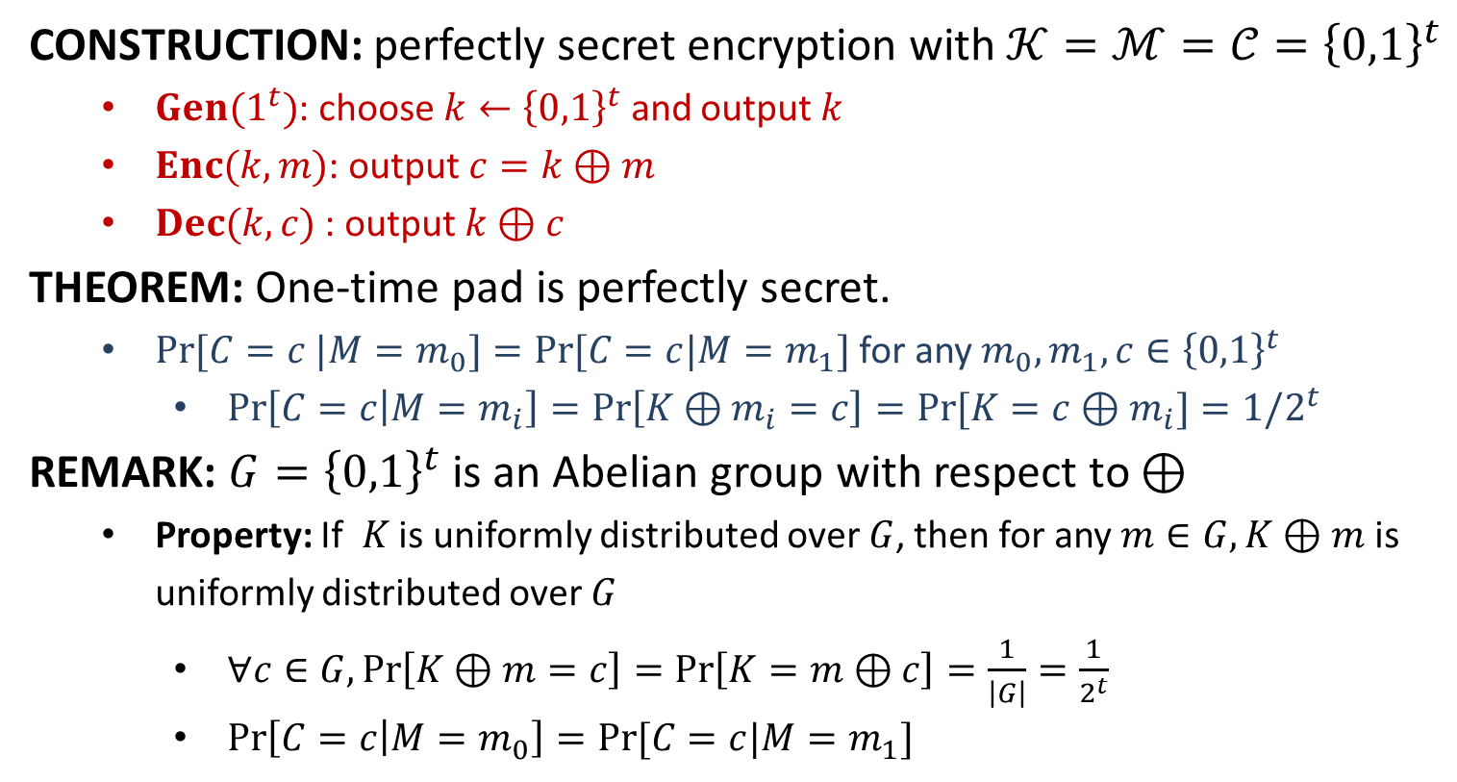
One-Time Pad
CONSTRUCTION: perfectly secret encryption with $𝒦=ℳ=𝒞={\left\{0,1\right\}}^{t}$
$Gen(1^{t})$: choose $k←{\left\{0,1\right\}}^{t}$ and output $k$
$Enc(k,m)$: output $c=k⊕m$
$Dec(k,c)$ : output $k⊕c$
THEOREM: One-time pad is perfectly secret.
$Pr⁡[C=c |M=m_{0}]=Pr⁡[C=c|M=m_{1}]$ for any $m_{0},m_{1}, c∈{\left\{0,1\right\}}^{t}$
$\operatorname{Pr}\left[C=c | M=m_{i}\right]=\operatorname{Pr}\left[K⊕m_{i}=c\right]=Pr⁡[K=c⊕m_{i}]=1/2^{t}$
REMARK: ${G=\left\{0,1\right\}}^{t}$ is an Abelian group with respect to $⊕$
Property: If $K$ is uniformly distributed over $G$, then for any $m∈G, K⊕m$ is uniformly distributed over $G$
$∀c∈G, Pr\left[K⊕m=c\right]=\operatorname{Pr}\left[K=m⊕c\right]=\frac{1}{\left|G\right|}=\frac{1}{2^{t}}$
$\operatorname{Pr}\left[C=c | M=m_{0}\right]=Pr⁡[C=c|M=m_{1}]$

Slide 37
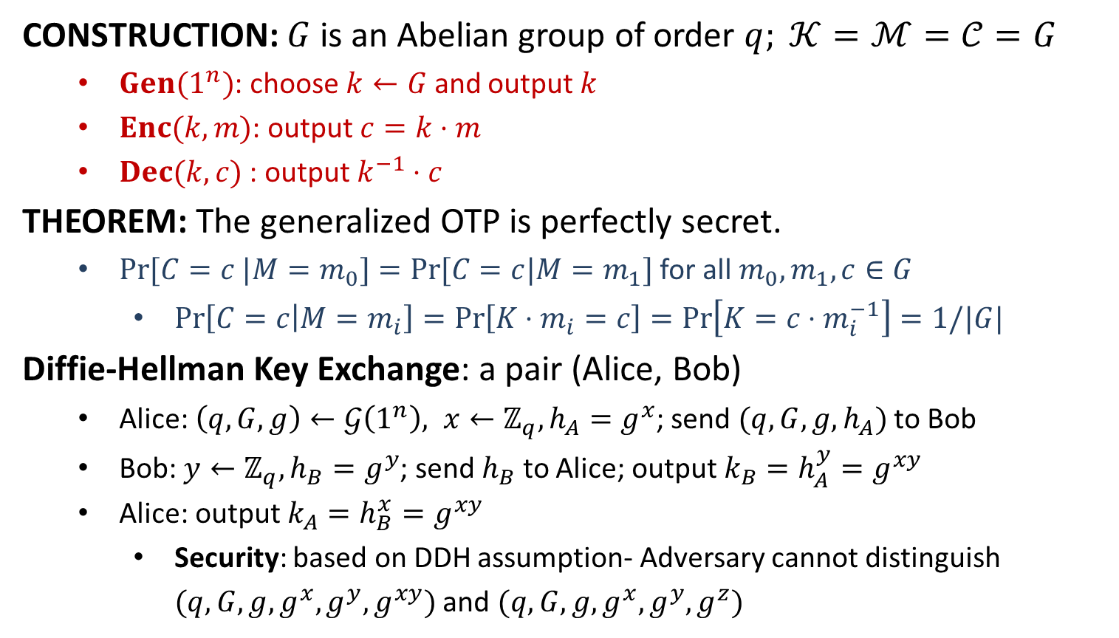
Generalizing OTP and Key Exchange
CONSTRUCTION: $G$ is an Abelian group of order $q; 𝒦=ℳ=𝒞=G$
$Gen(1^{n})$: choose $k←G$ and output $k$
$Enc(k,m)$: output $c=k⋅m$
$Dec(k,c)$ : output $k^{−1}⋅c$
THEOREM: The generalized OTP is perfectly secret.
$Pr⁡[C=c |M=m_{0}]=Pr⁡[C=c|M=m_{1}]$ for all $m_{0}, m_{1}, c∈G$
$\operatorname{Pr}\left[C=c | M=m_{i}\right]=\operatorname{Pr}\left[K⋅m_{i}=c\right]=\operatorname{Pr}\left[K=c⋅m_{i}^{−1}\right]=1/|G|$
Diffie-Hellman Key Exchange: a pair (Alice, Bob)
Alice: $\left(q,G,g\right)←𝒢\left(1^{n}\right), x←ℤ_{q}, h_{A}=g^{x}$; send $(q,G,g,h_{A})$ to Bob
Bob: $y←ℤ_{q}, h_{B}=g^{y}$; send $h_{B}$ to Alice; output $k_{B}=h_{A}^{y}=g^{xy}$
Alice: output $k_{A}=h_{B}^{x}=g^{xy}$
Security: based on DDH assumption- Adversary cannot distinguish $(q,G,g,g^{x},g^{y},g^{xy})$ and $(q,G,g,g^{x},g^{y},g^{z})$

